Slide 1


Individual Research Project
DataWise

Slide 2
Presentation Plan
I – New problem and related work
Previous problem and limitations
New problem
Related work
II – Coding
Frameworks
Advancement so far
III - Timeline

Slide 3
I - Previous problem & limitations
“The ground station monitors a specific bounding box and if a large number of aircrafts is expected in the bounding box, the FL process is applied (with the aircrafts being the nodes and the ground station the central server) to train an encoder-decoder that will be used to send compressed data”
Limitations:
What choice for the bounding box ?
Risk of more important bandwidth usage because of the FL process
Risk of a slow training phase
Auto-encoders are often lossy compressors

Slide 4
New problem
When an aircraft has a large enough amount of flight trajectories recorded, it is selected for the training of a model using FL
Input of the model (NN) : metadata (destination, origin, aircraft type, meteorological data…)
Output: 4D trajectory.
Before each departure, the trained model is used to predict the expected trajectory.
During the flight, the aircraft determines whether its 4D coordinates are close enough to the normal trajectory (according to a certain threshold).
For the GS, no message received means the position of the aircraft can be inferred from the predicted trajectory

Slide 5
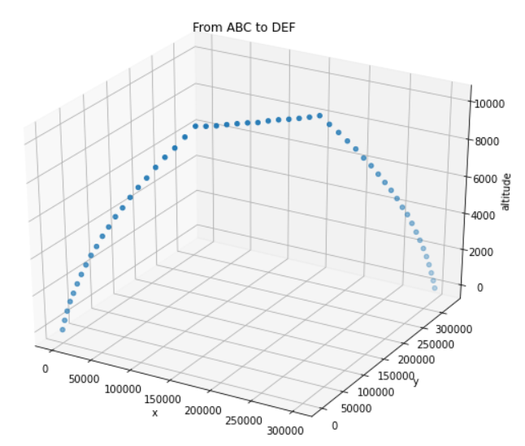


vs. (x,y,z,t)
Model training
“Here is your expected trajectory”
Able to predict 4D trajectories from meta data
“No news good news !”
Ready for departure
During flight
On ground

Slide 6
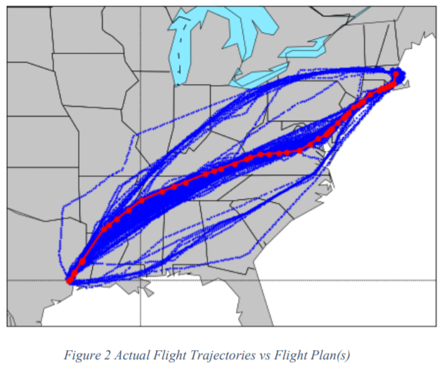
Comments
Flight anomalies are commonplace:
The main factors influencing a trajectory are - Convective weather cells
- Temperature
- Wind vector map
In case of communication, trajectory “adjustment” to resume communication-less flight

Slide 7
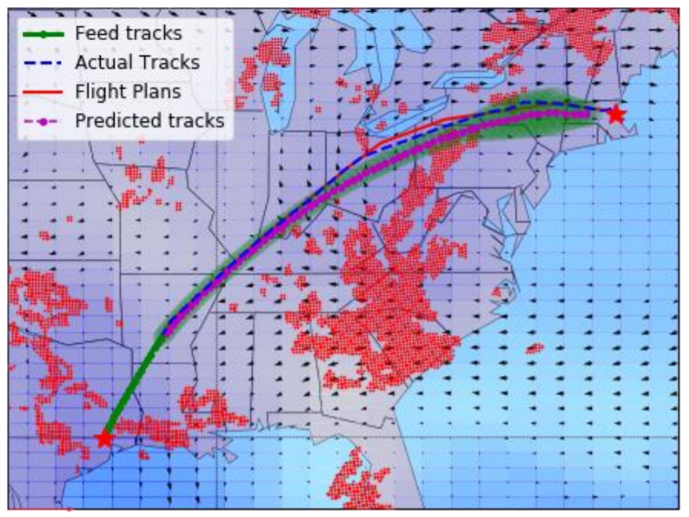
Related work
“Predicting Aircraft Trajectories: A Deep Generative Convolutional Recurrent Neural Networks Approach” – Liu et al.
LSTM for encoding and decoding
Integration of Convolutional layers for the exploitation of weather features
Usage of Kalman filters for the smoothing of predicted trajectories

Slide 8
II - Coding
2 main frameworks for federated learning
Tensorflow & Pytorch frameworks
One round of federated learning is reduced to a single function call

Slide 9
Advancements so far
Dataset research / creation
Code understanding

Slide 10
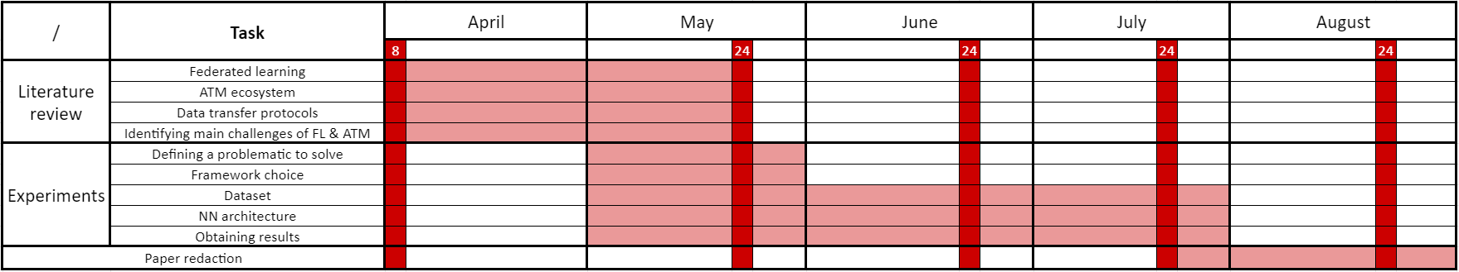
GANTT chart

Slide 11
Challenges & Questions
Only real challenge: obtaining a larger flight trajectory dataset (paid subscriptions required) along with the associated meteorological data
Plan for now: Understanding the code and adding a layer of federated learning. In the future, further refinements could be to add the improvements to FL found in the literature

Slide 12
Ideas 1
Ground station has a 4D trajectory NN predictor.
Before the start of the flight, the GS runs the NN which predicts the expected trajectory of the aircraft as a sequence of 4D points, evenly spaced in time
The GS sends the trajectory to the aircraft, which saves it in its memory
During the flight, instead of sending ADS-B data, the airplane compares the unsent ADS-B message with the trajectory.
If the message is similar to the prediction (e.g. the difference is under a certain threshold), the message is not sent. Else, if the error can pause a threat to airspace security, the message is sent.
If rectifications can be made, the prediction adjusts on both ends to resume message-less flight. Else, ADS-B communication resumes until perturbations end.

Slide 13
We want to go from airport ABC to airport DEF while sending as little Mode-S data as possible
Ground phase
Connection with GS
Aerial phase
Connection with GS if needed
Get first L 4D data points
Air → Ground comms
Aircrafts with enough ABC to DEF historical data: Weather & actual trajectory
Start of wireless travelling
Predict L+1th point
Wait Δt
No comms
Are our coordinates close to the prediction?
Wait Δt
« n ← n+1 »
FL process
Receive NN model
Y
N
*
Train NN with local data
Send weights to GS
Use prediction as data point
Get & use real coordinates as data point
No comms
Air → Ground comms
Model averaging → new aggregated model
Predict (n+1)^{th} point
1 hour since last weather
check AND weather differs from forecasts?
No comms
Threshold reached (Accuracy, n° of rounds…) ?
Y
N
GS = Ground Station
N
Y
L = Delay parameter
Stop process
*: The aircraft does not use its real coordinates for the next predictions to avoid divergence between the predictions from the aircraft and the GS
= Aircraft Action
Receive trained NN model from GS & Take off
Ground → Air comms
Air → Ground comms for the rest
= GS Action

Slide 14
For clarity, make schema with paper maps used in prez

